Slide 1
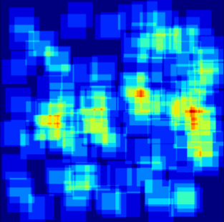


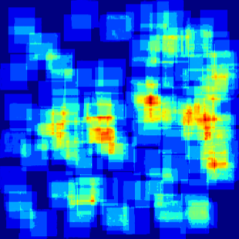
prediction map
Count-ception
L1 loss
target map
Target construction network

